Slide 1
Introduction to ML
Chapter 1

Slide 2
AI
Artificial Intelligence is the ability for a computer to think, learn and simulate human mental processes, such as perceiving, reasoning, and learning.
It can also independently perform complex tasks that once required human input.
Examples of these tasks are visual perception, speech recognition, decision-making, and translation between languages.

Slide 3
Fields in AI
ML -teaching computers to learn from data and make decisions (prediction, interpretation…)
NLP- enables computers to comprehend, generate, and manipulate human language.(understand human/natural languages)
Expert system -simulate the judgment and behavior of a human or an organization that has expertise and experience in a particular field.
Robotics -design, construction, operation, and use of robots.
Computer vision (how machine see?)– enable machines to recognize images and describe them correctly

Slide 4
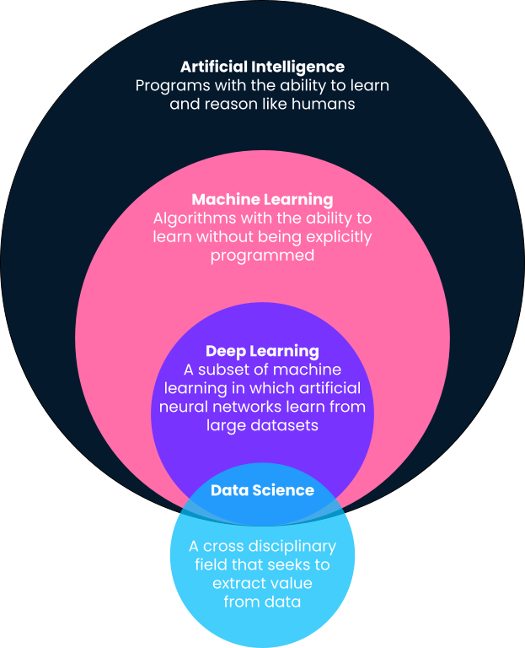
ML
A subset of artificial intelligence that enables systems to learn from data and improve their performance over time without explicit programming.

Slide 5
History of Machine Learning
Reading assignment.

Slide 6
Data Mining
Data Mining is the process of extracting useful patterns, relationships, or knowledge from large amounts of data.
Goals of Data Mining
Prediction: Predict unknown or future values based on known data (e.g., predicting customer churn).
Description: Find patterns that describe the data in a human-understandable form (e.g., association rules like "People who buy bread also buy butter").
Classification: Assign items to predefined categories or classes.
Clustering: Group similar data points into clusters without predefined labels.
Anomaly Detection: Identify outliers or unusual data points (e.g., fraud detection).

Slide 7
Process of Data Mining
Understanding the Problem: Define the objectives clearly.
Data Collection: Gather relevant data from different sources.
Data Preprocessing: Clean the data (handling missing values, noise, etc.).
Data Transformation: Normalize or transform the data into an appropriate format.
Mining the Data: Apply techniques to extract patterns.
Evaluation: Assess the patterns for usefulness and validity.
Deployment: Apply the extracted knowledge in real-world decision-making.

Slide 8
Knowledge Discovery in Databases
KDD is the overall process of discovering useful knowledge from data.
Data Mining is one important step inside KDD.
KDD is like a whole pipeline, and Data Mining as the heart of it.
Process of KDD
Selection: Choose the data relevant to the task.
Preprocessing: Cleanse and prepare the data.
Transformation: Transform the data into formats suitable for mining (e.g., aggregation, normalization).
Data Mining: Apply algorithms to discover patterns.
Interpretation/Evaluation: Make sense of the discovered patterns, validate their significance, and present the knowledge.

Slide 9
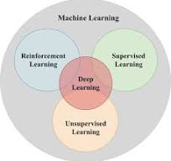
Types of Machine Learning
Supervised Learning: Learning from labeled data.
Unsupervised Learning: Learning from unlabeled data.
Reinforcement Learning: Learning through feedback from actions

Slide 10
Supervised Learning
An Algorithm that learns from labeled training data.
Key Algorithms: Linear regression, decision trees, support vector machines.
In supervised learning, algorithms learn to map inputs to known outputs based on training data.
Common applications include spam detection in emails and predicting house prices based on features like location and size. Image classification, doc classification, sentiment analysis, etc

Slide 11
Unsupervised Learning
An Algorithm that identifies patterns in unlabeled data.
Key Algorithms: K-means clustering, hierarchical clustering, Principal Component Analysis (PCA),anomaly detection…
Unsupervised learning helps in discovering underlying patterns in data without predefined labels.
Examples include customer segmentation in marketing and clustering similar items in large datasets. Fraud detection, recommender system, document clustering, keyword extraction

Slide 12
Classification and clustering
Classification involves assigning data into predefined categories based on specific attributes.
For example, using algorithms trained on labeled data, emails can be classified as 'spam' or 'not spam'.
Clustering groups data into clusters based on similarities without predefined labels.
Classification is about predicting categories based on labeled training data while Clustering is about discovering inherent groupings in unlabeled data.

Slide 13
Reinforcement Learning
Algorithm learns by interacting with an environment and receiving feedback.
Key Concepts: Agents, states, actions, rewards.
In reinforcement learning, an agent learns to make decisions by taking actions in an environment to maximize cumulative rewards.
Applications include robotics, game playing , and self-driving cars, where continuous learning is vital.

Slide 14
Machine Learning Process
The machine learning process consists of several stages, starting with data collection and ending with model deployment
Each step is crucial for developing an effective ML model that can generalize well to new data.
Steps:
Data Collection, Data Preprocessing, Model Selection, Model Training, Model Evaluation and Deployment

Slide 15
Data Collection
Importance of high-quality data.
High-quality data is essential for training accurate models.
Poor data can lead to misleading results.
Common data sources include online repositories, web scraping, surveys, and web scraping techniques.
There are many techniques for data collection. Eg. Survey and Questionnaires, interview, observation, web scraping, public dataset etc.

Slide 16
Data Preprocessing
Data preprocessing involves cleaning the data to remove inaccuracies and converting it into a usable format.
Techniques such as normalization and feature selection help improve model performance and interpretability.
stop word removal, data splitting(tokenization), normalization(ensure similar concept represented in the same way)

Slide 17
Model Training
Model training is the process of teaching a machine learning algorithm to recognize patterns in a data.
Techniques like cross-validation ensure that the model generalizes well and is not just memorizing the training data.

Slide 18
Model Evaluation
Evaluating model performance involves using metrics like accuracy, precision, and recall to assess its effectiveness.
A confusion matrix provides a comprehensive view of true vs. predicted values, helping to identify areas for improvement.

Slide 19
Popular Machine Learning Libraries
Popular ML libraries like TensorFlow and Scikit-learn provide robust tools for building and deploying models.
Keras offers a user-friendly interface for deep learning, making it accessible for both beginners and experts.
Deep learning is a subset of machine learning that utilizes neural networks with many layers (hence "deep") to model complex patterns in large datasets.
It has gained significant popularity due to its success in various applications, such as image and speech recognition, natural language processing, and more.

Slide 20
Applications of Machine Learning
Machine learning has diverse applications across industries, enhancing capabilities and decision-making.
In healthcare, ML aids in disease diagnosis, while in finance, it helps detect fraudulent activities.

Slide 21
Challenges in Machine Learning
Common challenges include over-fitting, where a model learns noise instead of patterns, and bias in data that can skew results.
Interpretability is another critical issue, as complex models can be difficult to understand and explain to stakeholders.

Slide 22
Future of Machine Learning
The future of machine learning is promising, with advancements in areas like natural language processing and computer vision.
As automation increases, ethical considerations will become increasingly important in developing responsible AI systems.

Slide 23
Ethical Considerations
Ethical considerations in machine learning include ensuring fairness, transparency, and accountability in AI systems.
Organizations must be vigilant about biases in data and model outcomes to promote trust and reliability.

Slide 24
Thanks

